Slide 1



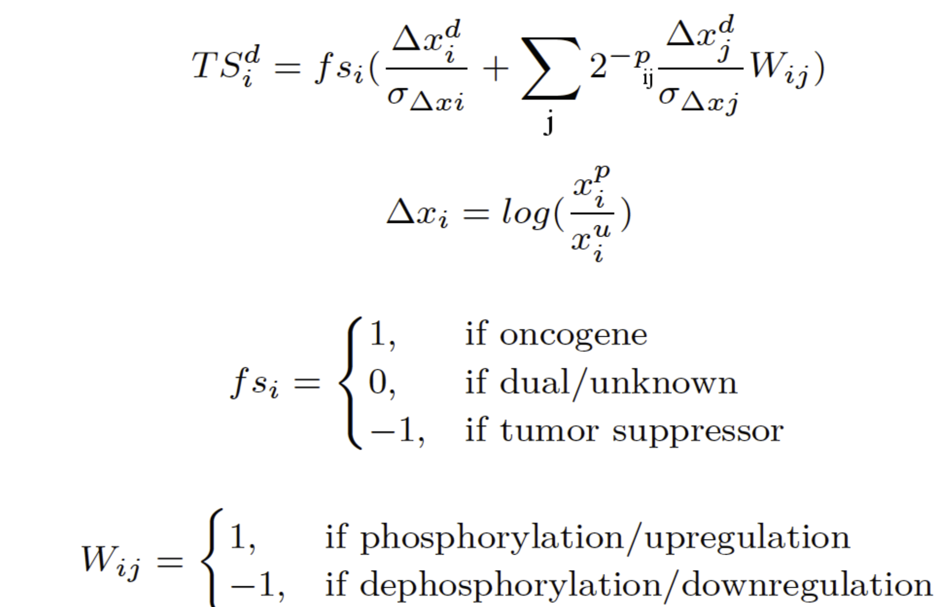
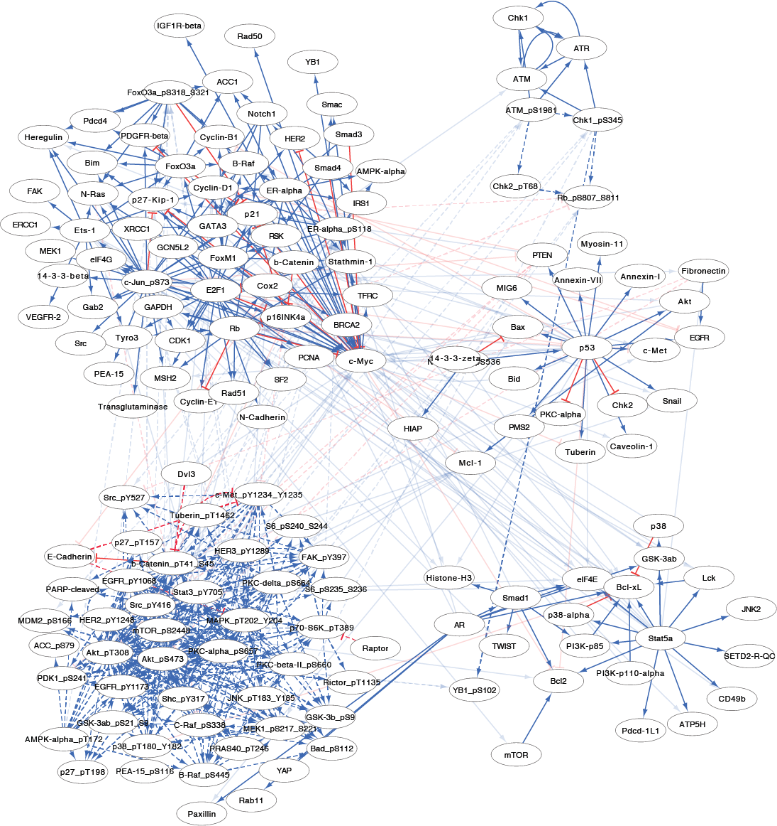
Discovery of Adaptive Resistance Pathways and Anti-Resistance Combination Therapies in Cancer from Phosphoproteomic Data
Augustin Luna¹, Ozgun Babur², Gordon Mills³, Chris Sander¹, Anil Korkut⁴
1 Biostatistics and Computational Biology, Dana-Farber Cancer Institute, Boston MA, 2 Computational Biology, OHSU, Portland, OR, 3 Department of Systems Biology, UT MD Anderson Cancer Center, Houston, TX
4 Bioinformatics and Computational Biology, UT MD Anderson Cancer Center, Houston, TX
Email: akorkut@mdanderson.org
Introduction
TargetScore
Resistance to targeted therapies, either intrinsic (pre-existing at the time of treatment) or acquired (emerged as tumor adapts to therapy), is a major challenge in modern oncology. Blocking multiple escape routes using drug combinations is the best solution to drug resistance. However, the discovery of effective combinations remains a challenging task due to complexity of the underlying biological processes and inter-tumor heterogeneity. Here we developed a statistical pathway analysis method that (i) reveals pathways involved in drug activity and adaptive resistance, (ii) nominates combination therapies to down-regulate the resistance pathways. The method is based on the rationale that (i) targeting a specific genomic aberration may lead to activation of compensatory pathways (e.g., via feedback loops in short-term or secondary oncogenic alterations in long-term) and subsequent resistance, (ii) collective changes in pathway activities are better predictors of resistance and mitigation strategies than abundances of individual molecules.
A
B
Figure 3: TargetScore calculation. A) A TargetScore (TS) quantifies the adaptive pathway responses to a perturbation as a sum of the response from each individual protein and its pathway neighborhood. The calculation combines the cell type-specific drug response data with signaling network information extracted from signaling databases. High TargetScore identifies proteins involved in adaptive response (e.g., up-regulation of RTK expression by MEK inhibitor via a feedback loop) and low TargetScore corresponds to the immediate impact of the drug (e.g., inhibition of ERK phosphorylation by MEK inhibitor). B) In the mathematical formulation, fsi represents the functional score of the node of interest, Δxi is the proteomic response log-normalized with respect to the unperturbed (or pre-treatment) level. The 𝜎∆𝑥𝑖 is the standard deviation of Δxi over all samples in the study and all drug doses. Division of Δx by σ normalizes a readout with respect to the dynamic range of the corresponding antibody and removes biases related to epitope sensitivity of antibodies. Node j is a node in the pathway neighborhood of the node i, with readout Δxj and standard deviation 𝜎∆𝑥𝑗. pij is the pathway distance between the nodes i and j. Wij represents the signaling interaction between nodes i and j extracted from pathway databases. The cumulative TS over multiple doses can be calculated as the area under the curve of TS versus drug doses.
Figure 1: Adaptive resistance concept. Drug perturbations can lead to the immediate impact of down-regulation of target pathways (e.g., inhibition of ERK phosphorylation by MEK inhibitor) and up-regulation of compensatory responses that lead to adaptation of tumor cells and subsequent resistance to therapy (e.g., up-regegulation of RTK expression by MEK inhibitor via a feedback loop). The adaptive resistance can be overcome by targeting these compensatory pathways.
Network modeling
Figure 4: Network model construction. Network models are constructed using the signaling data stored in Pathway Commons (PC) database and manual curation/correction by experts. PC integrates detailed human pathway data from multiple public resources such as Reactome, NCI PID, PhosphoSitePlus, Panther Pathways, and HumanCyc. Automated pathway extraction is achieved using algorithms embedded in the BioPAX/PaxTools pathway analysis language and software suite. In order to delineate the pathway interactions captured by RPPA data, we identified 4 different relation types: phosphorylation, dephosphorylation, expression up-regulation, and expression down-regulation. The first two relations can be used to explain phospho-protein changes, and the last two can be used to explain total protein changes. Using the BioPAX-pattern framework, we define a set of patterns to detect such relations and identify signaling interactions between phospho-proteomic entities (e.g., protein A and B).
Arrows: Red dashed inhibition: dephosphorylation, red solid inhibition: expression down-regulation, blue dashed arrow: phosphorylation, and blue solid arrow: expression up-regulation.
Method
Response to BET inhibition in ovarian cancer
D
C
Figure 5: Network model construction. A) Four ovarian cancer cell lines (OVCAR3, OVCAR4, IGROV1, and COV318) were treated with the BET-BRD inhibitor JQ1 in 10 drug doses (5-0.01 μM in 2-fold serial dilutions). 24 hr after drug administration, the perturbed cells are harvested for RPPA analysis. In control experiments (i.e., no drug condition), cells are treated with the DMSO drug vehicle for 24 hr. Cell viability is measured using the resazurin assay (72 hr after drug treatment). B) Each experiment is run in 3 biological and 5 technical replicates (in serial dilutions). Each slide is interrogated with a particular antibody, so for each experimental condition 152 proteomic entities measuring both phoso-protein and total protein concentrations. C) Inhibition of the bromodomain and extra-terminal domain bromodomain (BET-BRD) proteins blocks transcription elongation and specifically inhibit expression of oncogenes including but not limited to c-Myc in various cancer contexts. D) TargetScore versus drug dose dependence. Labeled points have proteomic measurements that correlate with cell viability (> 0.7, Spearman) and the TargetScore is in the top 10%. Resistant cell lines (i.e. COV318) have more features marked with high and dose dependent TS. This suggests the existence of an adaptive resistance program in this cell line, which can be targeted with agents combined with JQ1. Examples of those drugs are PKC, PDK1 and EGFR inhibitors to overcome resistance to BET inhibition in this drug resistant ovarian model system.
Acknowledgements
Funding provided by the AL/CS is supported by US NIH grant (U41 HG006623-02), the NRSA Award (F32 CA192901), the NIGMS grant (P41 GM103504) and AK is supported by MD Anderson Cancer Center Support Grant P30CA016672 (Bioinformatics Shared Resource).
References
Figure 2: Computational protocol for identification of adaptive resistance pathways and the nomination of effective drug combinations. An important step in the calculation involves TargetScore (TS) calculation. High TargetScore identifies proteins involved in adaptive response (e.g., up-regulation of RTK expression by MEK inhibitor via a feedback loop) and low TargetScore corresponds to the immediate impact of the drug (e.g., inhibition of ERK phosphorylation by MEK inhibitor).
[1] Muranen, T. et al. Inhibition of PI3K/mTOR leads to adaptive resistance in matrix-attached cancer cells. Cancer Cell 21, 227–239 (2012).
[2] Kwong, L. N. et al. Co-clinical assessment identifies patterns of BRAF inhibitor resistance in melanoma. J. Clin. Invest. 125, 1459–1470 (2015).
[3] Krepler, C. et al. Personalized preclinical trials in BRAF inhibitor-resistant patient-derived xenograft models identify second-line combination therapies. Clin. Cancer Res. 22, 1592–1602 (2016).
[4] Muranen, T. et al. ERK and p38 MAPK activities determine sensitivity to PI3K/mTOR inhibition via regulation of MYC and YAP. Cancer Res. 76, 7168–7180 (2016).
[5] Zoeller, J. J., Bronson, R. T., Selfors, L. M., Mills, G. B. & Brugge, J. S. Niche-localized tumor cells are protected from HER2-targeted therapy via up-regulation of an anti-apoptotic program in vivo. npj Breast Cancer 3, 18 (2017).
[6] Sun, C. et al. Rational combination therapy with PARP and MEK inhibitors capitalizes on therapeutic liabilities in RAS mutant cancers. Sci. Transl. Med. 9, 5148 (2017).
[7] Zervantonakis, I. K. et al. Targeting apoptotic vulnerabilities in patient-derived ovarian cancer xenografts to enhance the efficacy of PI3K pathway inhibitors. Nat. Commun. (2017).
[8] Cerami, E. G. et al. Pathway Commons, a web resource for biological pathway data. Nucleic Acids Res. 39, D685–D690 (2011).

